Slide 1
CSE477
VLSI Digital Circuits
Fall 2002
Lecture 11: Designing for Speed
Mary Jane Irwin ( www.cse.psu.edu/~mji ) www.cse.psu.edu/~cg477
[Adapted from Rabaey’s Digital Integrated Circuits, ©2002, J. Rabaey et al.]
Notes:
NEEDS WORK

Slide 2
Cray was a legend in computers … said that he liked to hire inexperienced engineers right out of school, because they do not usually know what’s supposed to be impossible.
The Soul of a New Machine, Kidder, pg. 77

Slide 3
Review: CMOS Inverter: Dynamic
V_{DD}
t_{pHL} = f(R_{n}, C_{L})
t_{pHL} = 0.69 R_{eqn} C_{L}
t_{pHL} = 0.69 (3/4 (C_{L} V_{DD})/ I_{DSATn} )
= 0.52 C_{L} / (W/L_{n} k’_{n} V_{DSATn} )
V_{out}
C_{L}
R_{n}
V_{in} = V _{DD}
Notes:
So propagation delay is determined by the time to charge and discharge the load capacitor CL
SO, getting CL as small as possible is crucial to the realization of high-performance CMOS circuits
Today we look at dynamic inverter characteristics

Slide 4
Review: Designing Inverters for Performance
Reduce C_{L}
  internal diffusion capacitance of the gate itself
  interconnect capacitance
  fanout
Increase W/L ratio of the transistor
  the most powerful and effective performance optimization tool in the hands of the designer
  watch out for self-loading!
Increase V_{DD}
  only minimal improvement in performance at the cost of increased energy dissipation
Slope engineering - keeping signal rise and fall times smaller than or equal to the gate propagation delays and of approximately equal values
  good for performance
  good for power consumption
Notes:
Good design practice keeps drain diffusion areas as small as possible
Self-loading is when the intrinsic capacitance (diffusion capacitance) starts to dominate the extrinsic load formed by wiring and fanout.
Increasing VDD also has reliability concerns - oxide breakdown, hot-electron effects - that enforce firm upper bounds on the supply voltage in deep submicron processes.

Slide 5
Switch Delay Model
A
R_{eq}
A
R_{p}
R_{p}
R_{p}
B
A
B
R_{p}
R_{p}
A
R_{p}
A
C_{int}
R_{n}
C_{L}
A
A
R_{n}
C_{L}
A
R_{n}
R_{n}
C_{L}
R_{n}
C_{int}
A
B
B
INVERTER
NOR
NAND
Notes:
Logic is transformed into an equivalent RC network that includes the effect of internal node capacitances – due to the source grain of the two fets in series and the overlap gate capacitances of the two fets in series

Slide 6
Input Pattern Effects on Delay
Delay is dependent on the pattern of inputs
Low to high transition
  both inputs go low
    delay is 0.69 R_{p}/2 C_{L} since two p-resistors are on in parallel
  one input goes low
    delay is 0.69 R_{p} C_{L}
High to low transition
  both inputs go high
    delay is 0.69 2R_{n} C_{L}
Adding transistors in series (without sizing) slows down the circuit
R_{p}
R_{p}
A
B
R_{n}
C_{L}
A
R_{n}
C_{int}
B

Slide 7
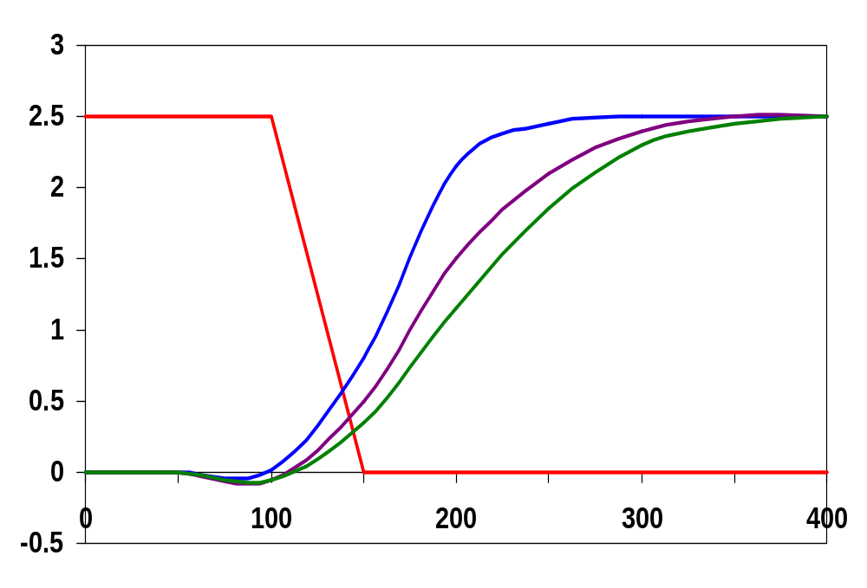
Delay Dependence on Input Patterns
2-input NAND with
NMOS = 0.5μm/0.25 μm
PMOS = 0.75μm/0.25 μm
C_{L} = 10 fF
A=B=1→0
Input Data Pattern | Delay (psec)
A=B=0→1 | 69
A=1, B=0→1 | 62
A= 0→1, B=1 | 50
A=B=1→0 | 35
A=1, B=1→0 | 76
A= 1→0, B=1 | 57
A=1 →0, B=1
Voltage, V
A=1, B=1→0
time, psec
Notes:
Gate sizing should result in approximately equal worst case rise and fall times.
Reason for difference in the last two delays is due to internal node capacitance of the pulldown stack. When B transitions to zero, the pullup only has to charge CL; when A=1 and B transitions to zero the pullup has to charge up both CL and Cint.
Note approx. equal rise and fall delays
For high to low transitions (first three cases), delay depends on the initial state of the internal nodes. E.g., when both inputs transition from 0 to 1, the worst case happens when the internal node has been initially charged (up to VDD-VTn).
Conclusions: Estimates of delay can be fairly complex – have to consider internal node capacitances and the data patterns.
NOTE A& B need to be flipped from previous figure for this to work !!!
Figures 6.8 (a) and (b) are reversed !!!!

Slide 8
Transistor Sizing
R_{p}
R_{p}
R_{p}
1
A
B
1
2
2
B
R_{n}
R_{p}
C_{int}
C_{L}
2
2
A
B
R_{n}
R_{n}
R_{n}
C_{L}
C_{int}
1
A
A
B
1
Notes:
Assumes Rp = Rn (and ignores the extra diffusion capacitance introduced by widening the transistors)
In DSM, even larger increases in the width are needed due to velocity saturation. For 2-input NANDs, the nmos transistors should be made 2.5 times as wide.
NAND implementation is clearly preferred over a NOR implementation, since a pmos stack series is slower than an nmos stack due to lower carrier mobility

Slide 9
Transistor Sizing a Complex CMOS Gate
B
A
C
D
OUT = !(D + A • (B + C))
A
D
B
C
Notes:
For class handout.

Slide 10
Transistor Sizing a Complex CMOS Gate
B
4
12
A
2
6
C
4
12
D
2
6
OUT = !(D + A • (B + C))
A
2
D
1
B
2
C
2
Notes:
For class lecture.
Red sizing assuming Rp = Rn
Follow short path first; note PMOS for C and B 4 rather than 3 – average in pull-up chain of three – (4+4+2)/3 = 3
Also note structure of pull-up and pull-down to minimize diffusion cap at output (e.g., single PMOS drain connected to output)
Green for symmetric response and for performance (where Rn = 3 Rp)
Sizing rules of thumb
PMOS = 3 * NMOS
1 in series = 1
2 in series = 2
3 in series = 3
etc.

Slide 11
Fan-In Considerations
A
B
C
D
A
C_{L}
B
C₃
Distributed RC model
(Elmore delay)
t_{pHL} = 0.69 R_{eqn}(C₁+2C₂+3C₃+4C_{L})
Propagation delay deteriorates rapidly as a function of fan-in – quadratically in the worst case.
C
C₂
D
C₁
Notes:
While output capacitance makes full swing transition (from VDD to 0), internal nodes only transition from VDD-VTn to GND
C1, C2, C3 (from junction capacitances as well as the gate-to-source and gate-to-drain capacitances (turned into capacitances to ground using the Miller effect)) on the order of 0.85 fF for W/L of 0.5/0.25 NMOS and 0.375/0.25 PMOS, CL of 3.47 fF with NO output load (all diffusion capacitance – intrinsic capacitance of the gate itself).
To give a 85 psec tpHL (simulated as 86 psec).
The simulated worst case low-to-high delay was 106 ps.

Slide 12
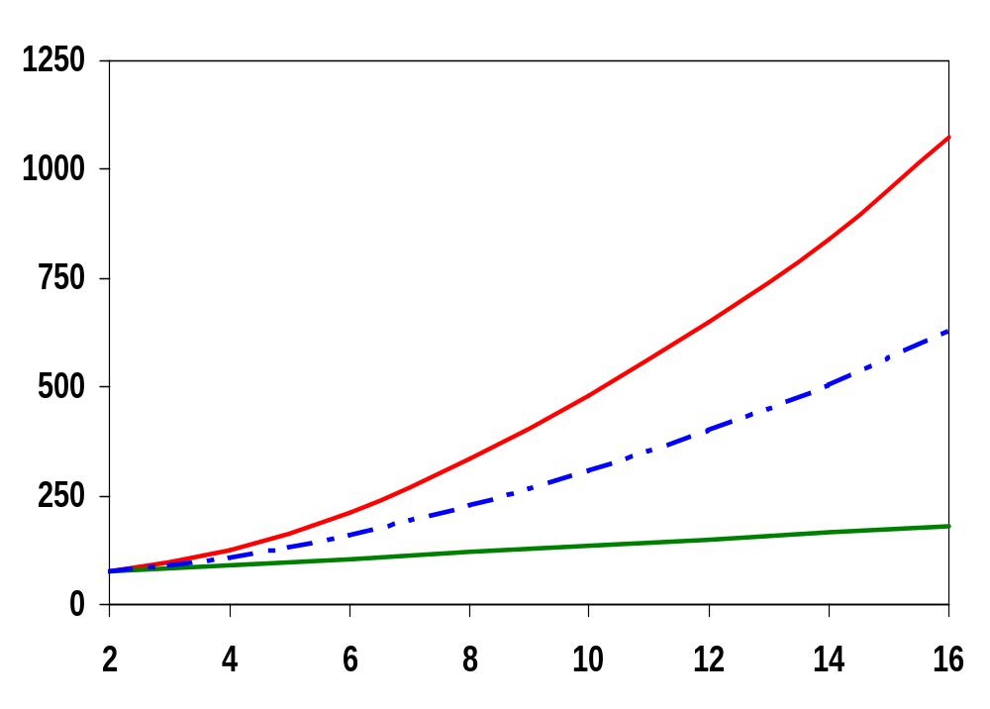
t_{p} as a Function of Fan-In
quadratic function of fan-in
t_{p} (psec)
t_{pHL}
t_{p}
t_{pLH}
linear function of fan-in
fan-in
Gates with a fan-in greater than 4 should be avoided.
Notes:
Fixed fan-out (NMOS 0.5 micron, PMOS 1.5 micron)
tpLH increases linearly due to the linearly increasing value of the diffusion capacitance of the pmos transistors (resistance remains unchanged)
tpHL increase quadratically due to the simultaneous increase in pull-down resistance and internal capacitance

Slide 13
Fast Complex Gates: Design Technique 1
Transistor sizing
  as long as fan-out capacitance dominates
Progressive sizing
Distributed RC line
M1 > M2 > M3 > … > MN
(the fet closest to the output should be the smallest)
In_{N}
MN
C_{L}
In₃
M3
C₃
In₂
M2
C₂
Can reduce delay by more than 20%; decreasing gains as technology shrinks
In₁
M1
C₁
Notes:
With transistor sizing, if the load capacitance is dominated by the intrinsic capacitance of the gate, widening the device only creates a “self loading” effect and the propagation delay is unaffected (and may even become worse).
For progressive sizing, M1 have to carry the discharge current from M2 (C1), M3 (C2), … MN and CL so make it the largest. MN only has to discharge the current from MN (CL)(no internal capacitances).
While progressive sizing is easy in a schematic, in a real layout it may not pay off due to design-rule considerations that force the designer to push the transistors apart, increasing internal capacitance.

Slide 14
Fast Complex Gates: Design Technique 2
Input re-ordering
  when not all inputs arrive at the same time
critical path
critical path
0→1
charged
In₃
1
charged
In₁
M3
C_{L}
M3
C_{L}
1
In₂
1
In₂
M2
C₂
M2
C₂
In₃
1
In₁
M1
C₁
M1
C₁
0→1
Notes:
For class handout

Slide 15
Fast Complex Gates: Design Technique 2
Input re-ordering
  when not all inputs arrive at the same time
critical path
critical path
charged
0→1
charged
In₃
1
C_{L}
In₁
M3
C_{L}
M3
1
In₂
1
In₂
M2
C₂
charged
M2
C₂
discharged
In₃
1
discharged
In₁
M1
C₁
charged
M1
C₁
0→1
delay determined by time to discharge C_{L}, C₁ and C₂
delay determined by time to discharge C_{L}
Notes:
For lecture.
Critical input is latest arriving signal – the path through the logic that determines the ultimate speed of the structure is called the critical path.
Place latest arriving signal (critical path) closest to the output can result in a speed up.

Slide 16
Sizing and Ordering Effects
A
3
B
3
C
3
D
3
A
4
4
C_{L}
= 100 fF
B
4
5
C₃
Progressive sizing in pull-down chain gives up to a 23% improvement.
Input ordering saves 5%
critical path A – 23%
critical path D – 17%
C
4
6
C₂
D
4
7
C₁

Slide 17
Fast Complex Gates: Design Technique 3
Alternative logic structures
F = ABCDEFGH
Notes:
Reduced fan-in -> deeper logic depth
Reduction in fan-in offsets, by far, the extra delay incurred by the NOR gate (second configuration).
Only simulation will tell which of the last two configurations is faster, lower power
Need to run the simulations to get real timing numbers – and power

Slide 18
Fast Complex Gates: Design Technique 4
Isolating fan-in from fan-out using buffer insertion
C_{L}
C_{L}
Real lesson is that optimizing the propagation delay of a gate in isolation is misguided.
Notes:
Reduce CL on large fan-in gates, especially for large CL, and size the inverters progressively to handle the CL more effectively

Slide 19
Fast Networks: Design Technique 5 - Logical Effort
The optimum fan-out for a chain of N inverters driving a load C_{L} is
f = √(C_{L}/C_{in})
  so, if we can, keep the fan-out per stage around 4.
Can the same approach (logical effort) be used for any combinational circuit?
  For a complex gate, we expand the inverter equation
t_{p} = t_{p0} (1 + C_{ext}/ γC_{g}) = t_{p0} (1 + f/γ)
  to
t_{p} = t_{p0} (p + g f/γ)
    t_{p0} is the intrinsic delay of an inverter
    f is the effective fan-out (C_{ext}/C_{g}) – also called the electrical effort
    p is the ratio of the instrinsic (unloaded) delay of the complex gate and a simple inverter (a function of the gate topology and layout style)
    g is the logical effort
N
Notes:
Logical effort first defined by Sutherland and Sproull in 1999

Slide 20
Intrinsic Delay Term, p
The more involved the structure of the complex gate, the higher the intrinsic delay compared to an inverter
Gate Type | p
Inverter | 1
n-input NAND | n
n-input NOR | n
n-way mux | 2n
XOR, XNOR | n 2^{n-1}
Ignoring second order effects such as internal node capacitances

Slide 21
Logical Effort Term, g
g represents the fact that, for a given load, complex gates have to work harder than an inverter to produce a similar (speed) response
  the logical effort of a gate tells how much worse it is at producing an output current than an inverter (how much more input capacitance a gate presents to deliver it same output current)
Gate Type | g (for 1 to 4 input gates)
 | 1 | 2 | 3 | 4
Inverter | 1
NAND |  | 4/3 | 5/3 | (n+2)/3
NOR |  | 5/3 | 7/3 | (2n+1)/3
mux |  | 2 | 2 | 2
XOR |  | 4 | 12

Slide 22
Example of Logical Effort
Assuming a pmos/nmos ratio of 2, the input capacitance of a minimum-sized inverter is three times the gate capacitance of a minimum-sized nmos (C_{unit})
B
A
B
A
A
A
A • B
A + B
A
A
B
A
B
Notes:
For class handout

Slide 23
Example of Logical Effort
Assuming a pmos/nmos ratio of 2, the input capacitance of a minimum-sized inverter is three times the gate capacitance of a minimum-sized nmos (C_{unit})
B
4
A
2
B
2
A
2
A
4
A
A • B
1
A + B
A
A
2
B
2
A
1
B
1
C_{unit} = 3
C_{unit} = 4
C_{unit} = 5
Notes:
For lecture
So the input capacitance of a 2-input NAND is 4/3 the capacitance of an inverter and for a 2-input NOR is 5/3

Slide 24
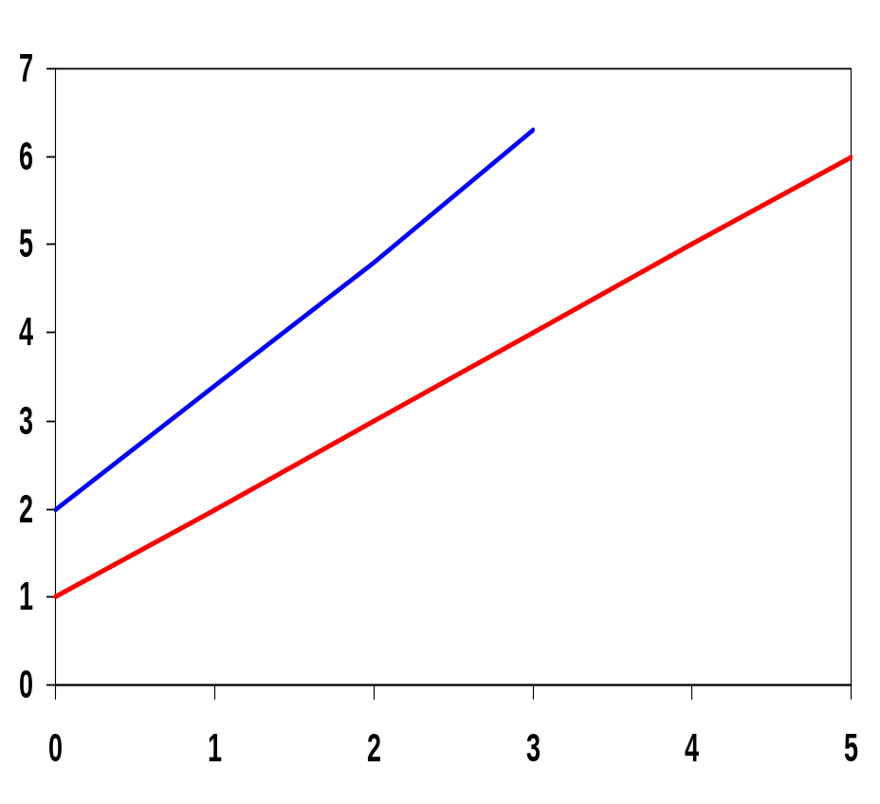
Delay as a Function of Fan-Out
The slope of the line is the logical effort of the gate
The y-axis intercept is the intrinsic delay
NAND2: g=4/3, p = 2
INV: g=1, p=1
normalized delay
effort delay
Can adjust the delay by adjusting the effective fan-out (by sizing) or by choosing a gate with a different logical effort
Gate effort: h = fg
intrinsic delay
fan-out f

Slide 25
Path Delay of Complex Logic Gate Network
Total path delay through a combinational logic block
t_{p} = ∑ t_{p,j} = t_{p0} ∑(p_{j} + (f_{j} g_{j})/γ )
So, the minimum delay through the path determines that each stage should bear the same gate effort
f₁g₁ = f₂g₂ = . . . = f_{N}g_{N}
Consider optimizing the delay through the logic network
how do we determine a, b, and c sizes?
1
c
a
b
C_{L}
5

Slide 26
Path Delay Equation Derivation
The path logical effort, G = ∏ g_{i}
And the path effective fan-out (path electrical effort) is F = C_{L}/g₁
The branching effort accounts for fan-out to other gates in the network
b = (C_{on-path} + C_{off-path})/C_{on-path}
The path branching effort is then B = ∏ b_{i}
And the total path effort is then H = GFB
So, the minimum delay through the path is
D = t_{p0} ( ∑p_{j} + (N √H)/ γ)
N
Notes:
the path instrinsic delay is a function of the types of logic gates in the path and is not affected by the sizing. The size factors of the individual gates in the chain, si, can then be derived by working from front to end (or vica-versa).

Slide 27
Path Delay of Complex Logic Gates, con’t
For gate i in the chain, its size is determined by
s_{i} = (g₁ s₁)/g_{i} ∏ (f_{j}/b_{j})
i-1
j=1
1
c
a
b
C_{L}
5
For this network
  F = C_{L}/C_{g1} = 5
  G = 1 x 5/3 x 5/3 x 1 = 25/9
  B = 1 (no branching)
  H = GFB = 125/9, so the optimal stage effort is √H = 1.93
    Fan-out factors are f₁=1.93, f₂=1.93 x 3/5 = 1.16, f₃ = 1.16, f₄ = 1.93
  So the gate sizes are a = f₁g₁/g₂ = 1.16, b = f₁f₂g₁/g₃ = 1.34 and c = f₁f₂f₃g₁/g₄ = 2.60
4
Notes:
Notice that inverters are assigned a larger fan-out than the more complex gates because they are better at driving loads.

Slide 28
Fast Complex Gates: Design Technique 6
Reducing the voltage swing
  linear reduction in delay
  also reduces power consumption
  requires use of “sense amplifiers” on the receiving end to restore the signal level (will look at their design when covering memory design)
t_{pHL} = 0.69 (3/4 (C_{L} V_{DD})/ I_{DSATn} )
= 0.69 (3/4 (C_{L} V_{swing})/ I_{DSATn} )

Slide 29
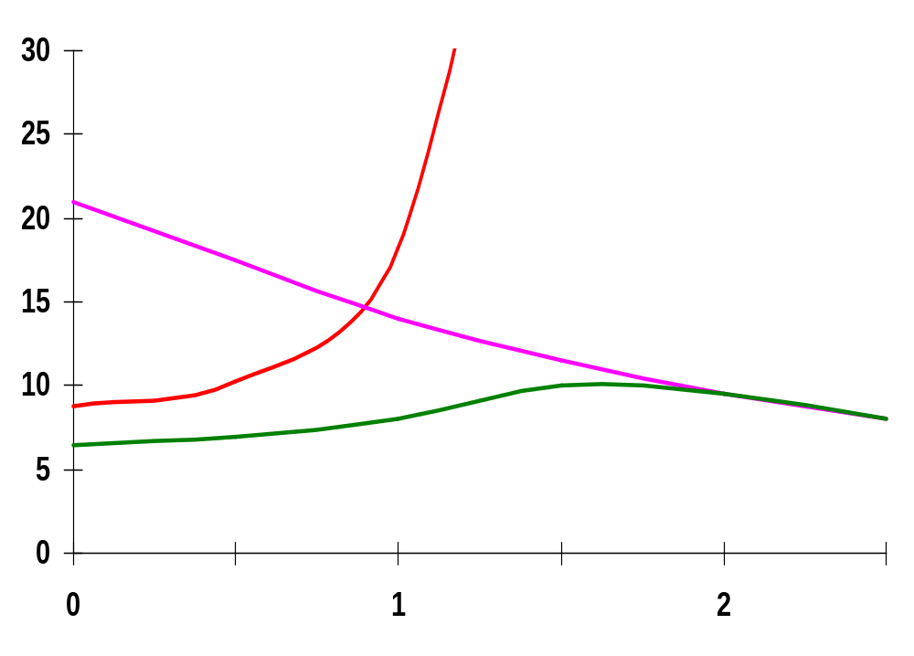
TG Logic Performance
Effective resistance of the TG is modeled as a parallel connection of R_{p} (= (V_{DD} – V_{out})/(-I_{Dp})) and R_{n} (=V_{DD} – V_{out})/I_{Dn})
W/L_{p}=0.50/0.25
0V
R_{n}
R_{p}
2.5V
V_{out}
R_{p}
R_{n}
Resistance, kΩ
2.5V
R_{eq} = R_{n} || R_{p}
W/L_{n}=0.50/0.25
V_{out}, V
So, the assumption that the TG switch has a constant resistive value, R_{eq}, is acceptable
Notes:
Req is relatively constant (= 8kohms in this particular case).

Slide 30
Delay of a TG Chain
0
0
0
0
V_{in}
V₁
V_{i}
V_{i+1}
V_{N}
5
C
5
C
5
C
5
C
V_{in}
R_{eq}
R_{eq}
R_{eq}
R_{eq}
V₁
V_{i}
V_{i+1}
V_{N}
C
C
C
C
Delay of the RC chain (N TG’s in series) is
t_{p}(V_{n}) = 0.69 ∑kCR_{eq} = 0.69 CR_{eq} (N(N+1))/2 ≈ 0.35 CR_{eq}N²
N
k=1
Notes:
We have seen that the delay grows quadratically in N (in this case in the number of t-gates in series) and increases rapidly with the number of switches in the chain. So t-gate network delay is proportional to N**2 (N is number of t-gates in series) – quadratic!
E.g., for 16 cascaded minimum-sized TG’s, each with an Req of 8kohms. The node capacitance is the sum of the capacitances of two nmos and pmos devices (junctions and drains). Gate inputs are assumed to be fixed, so there is no Miller multiplication. Capacitance values is approx. 3.6 fF for low to high transistions. The delay through the chain is
tp = 0.69 C Req (N(N+1))/2 = 0.69 x 3.6fF x 8kohms x (16x17)/2 = 2.7ns

Slide 31
TG Delay Optimization
Can speed it up by inserting buffers every M switches
0
0
0
0
0
0
V_{in}
V_{N}
5
C
5
C
5
5
C
5
C
5
C
M
Delay of buffered chain (M TG’s between buffer)
t_{p} = 0.69 ⎣N/M CR_{eq} (M(M+1))/2⎦ + (N/M - 1) t_{pbuf}
M_{opt} = 1.7 √ (t_{pbuf}/CR_{eq} ) ≈ 3 or 4
Notes:
Notice that the buffered chain is now linear in N – quadratic in M but M should be small
Taking tp derivative wrt 0 gives Mopt. The number of switches per segment grows with increasing values of tpbuf. Equals 3 of 4 or so in today’s technology. (Analysis ignores that tpbuf itself is a function of M).
This buffer insertion technique works to speed up the delay down long wires as well.
Consider 16TG chain example. Buffers = inverters (making sure correct polarity is output). for 0.5micron/0.25micron nfets and pfets in the TGs, simulated delay with 2TG per buffer is 154 ps, for 3TGs is 154ps, and for 4TG is 164ps. The insertion of buffering inverters reduces the delay by a factor of almost 2.

Slide 32
Next Lecture and Reminders
Next lecture
  Designing energy efficient logic
    Reading assignment – Rabaey, et al, 5.5 & 6.2.1
Reminders
  HW3 due Oct 10th (hand in to TA)
  Class cancelled on Oct 10th as make up for evening midterm
  I will be out of town Oct 10th through Oct 15th and Oct 18th through Oct 23rd, so office hours during those periods are cancelled
  We will have a guest lecturer on Oct 22nd
  Evening midterm exam scheduled
    Wednesday, October 16th from 8:15 to 10:15pm in 260 Willard
    Only one midterm conflict filed for so far

